Slide 1
Nature Mosaics
Created by Div. 4 & 7
Art inspired by Karen Klassen (Alberta)

Slide 2
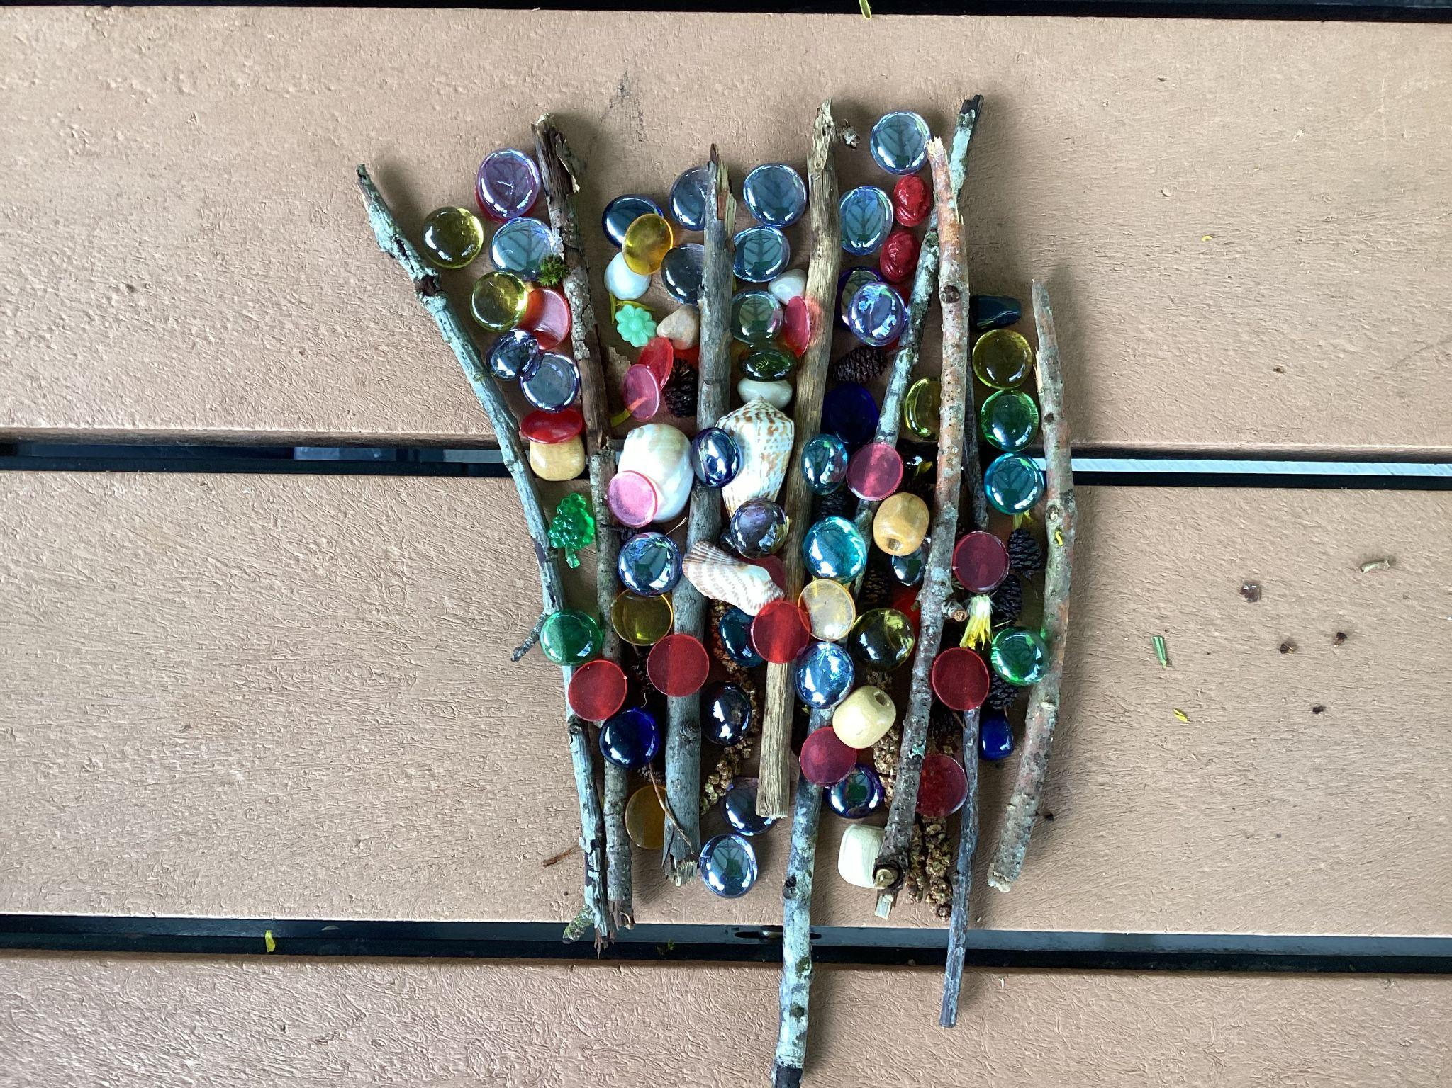
Jaxon and Sydney

Slide 3
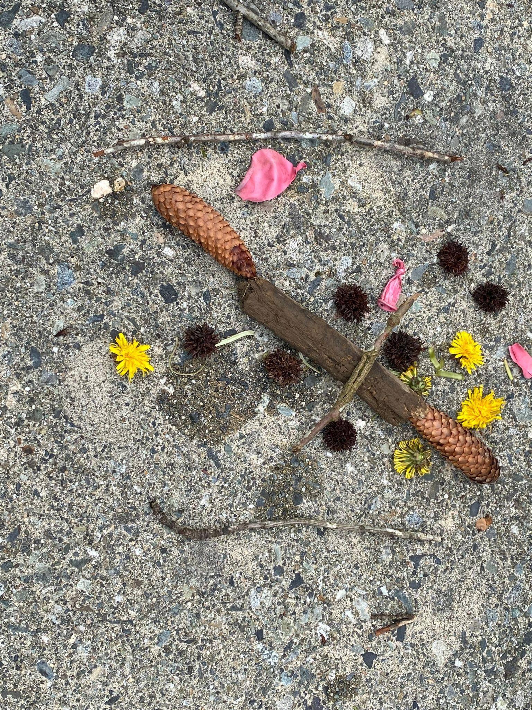
Max and Hunter

Slide 4
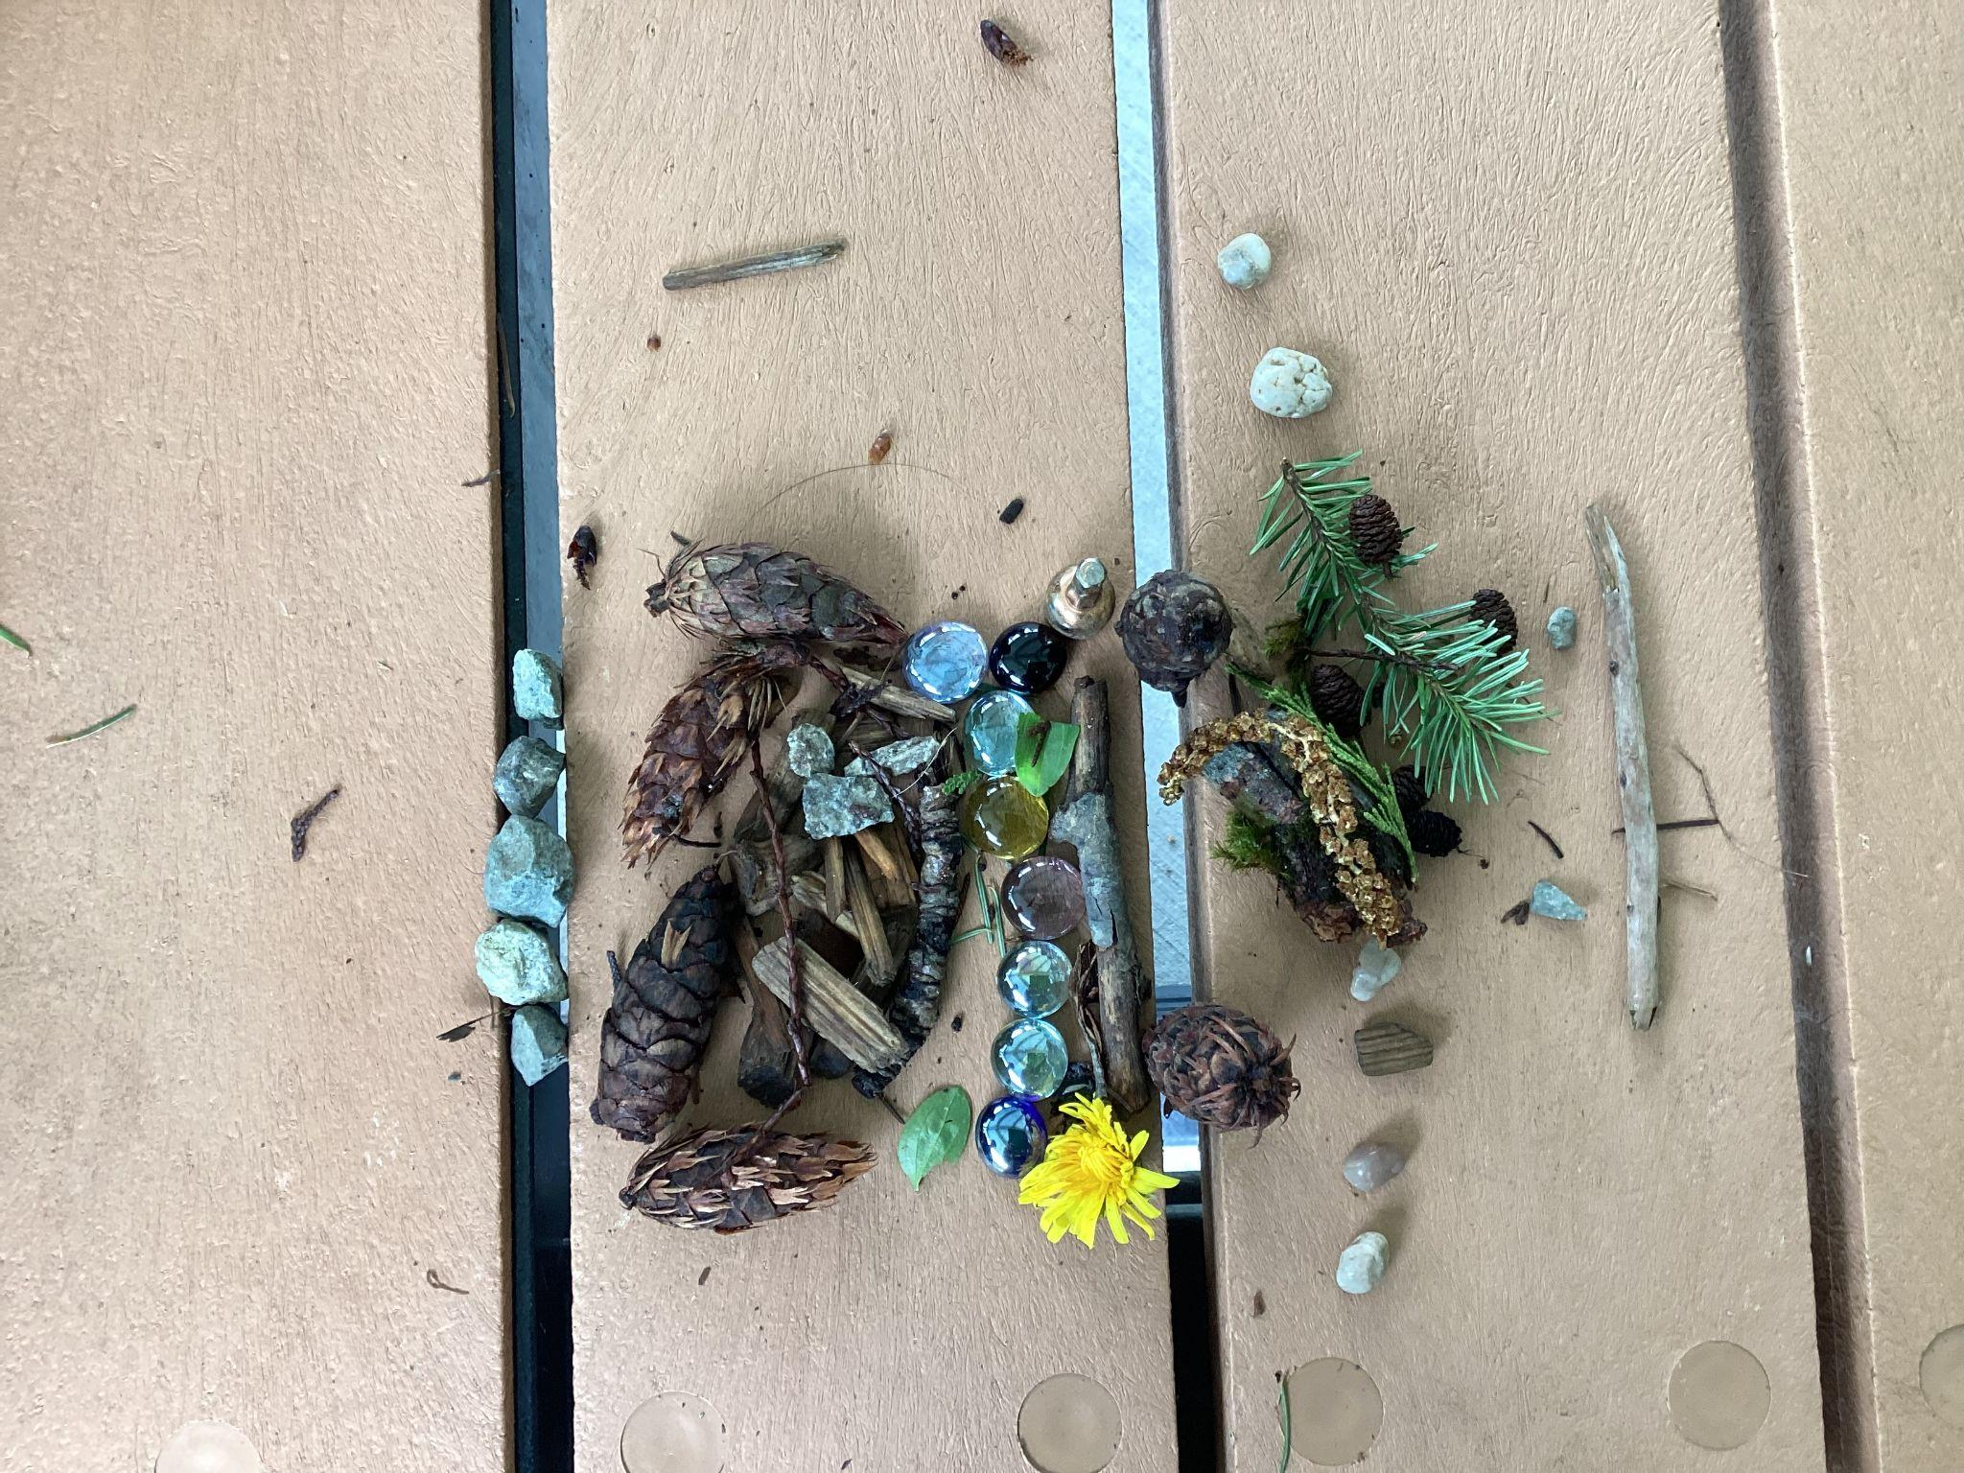
Sumatt and Shanaya

Slide 5
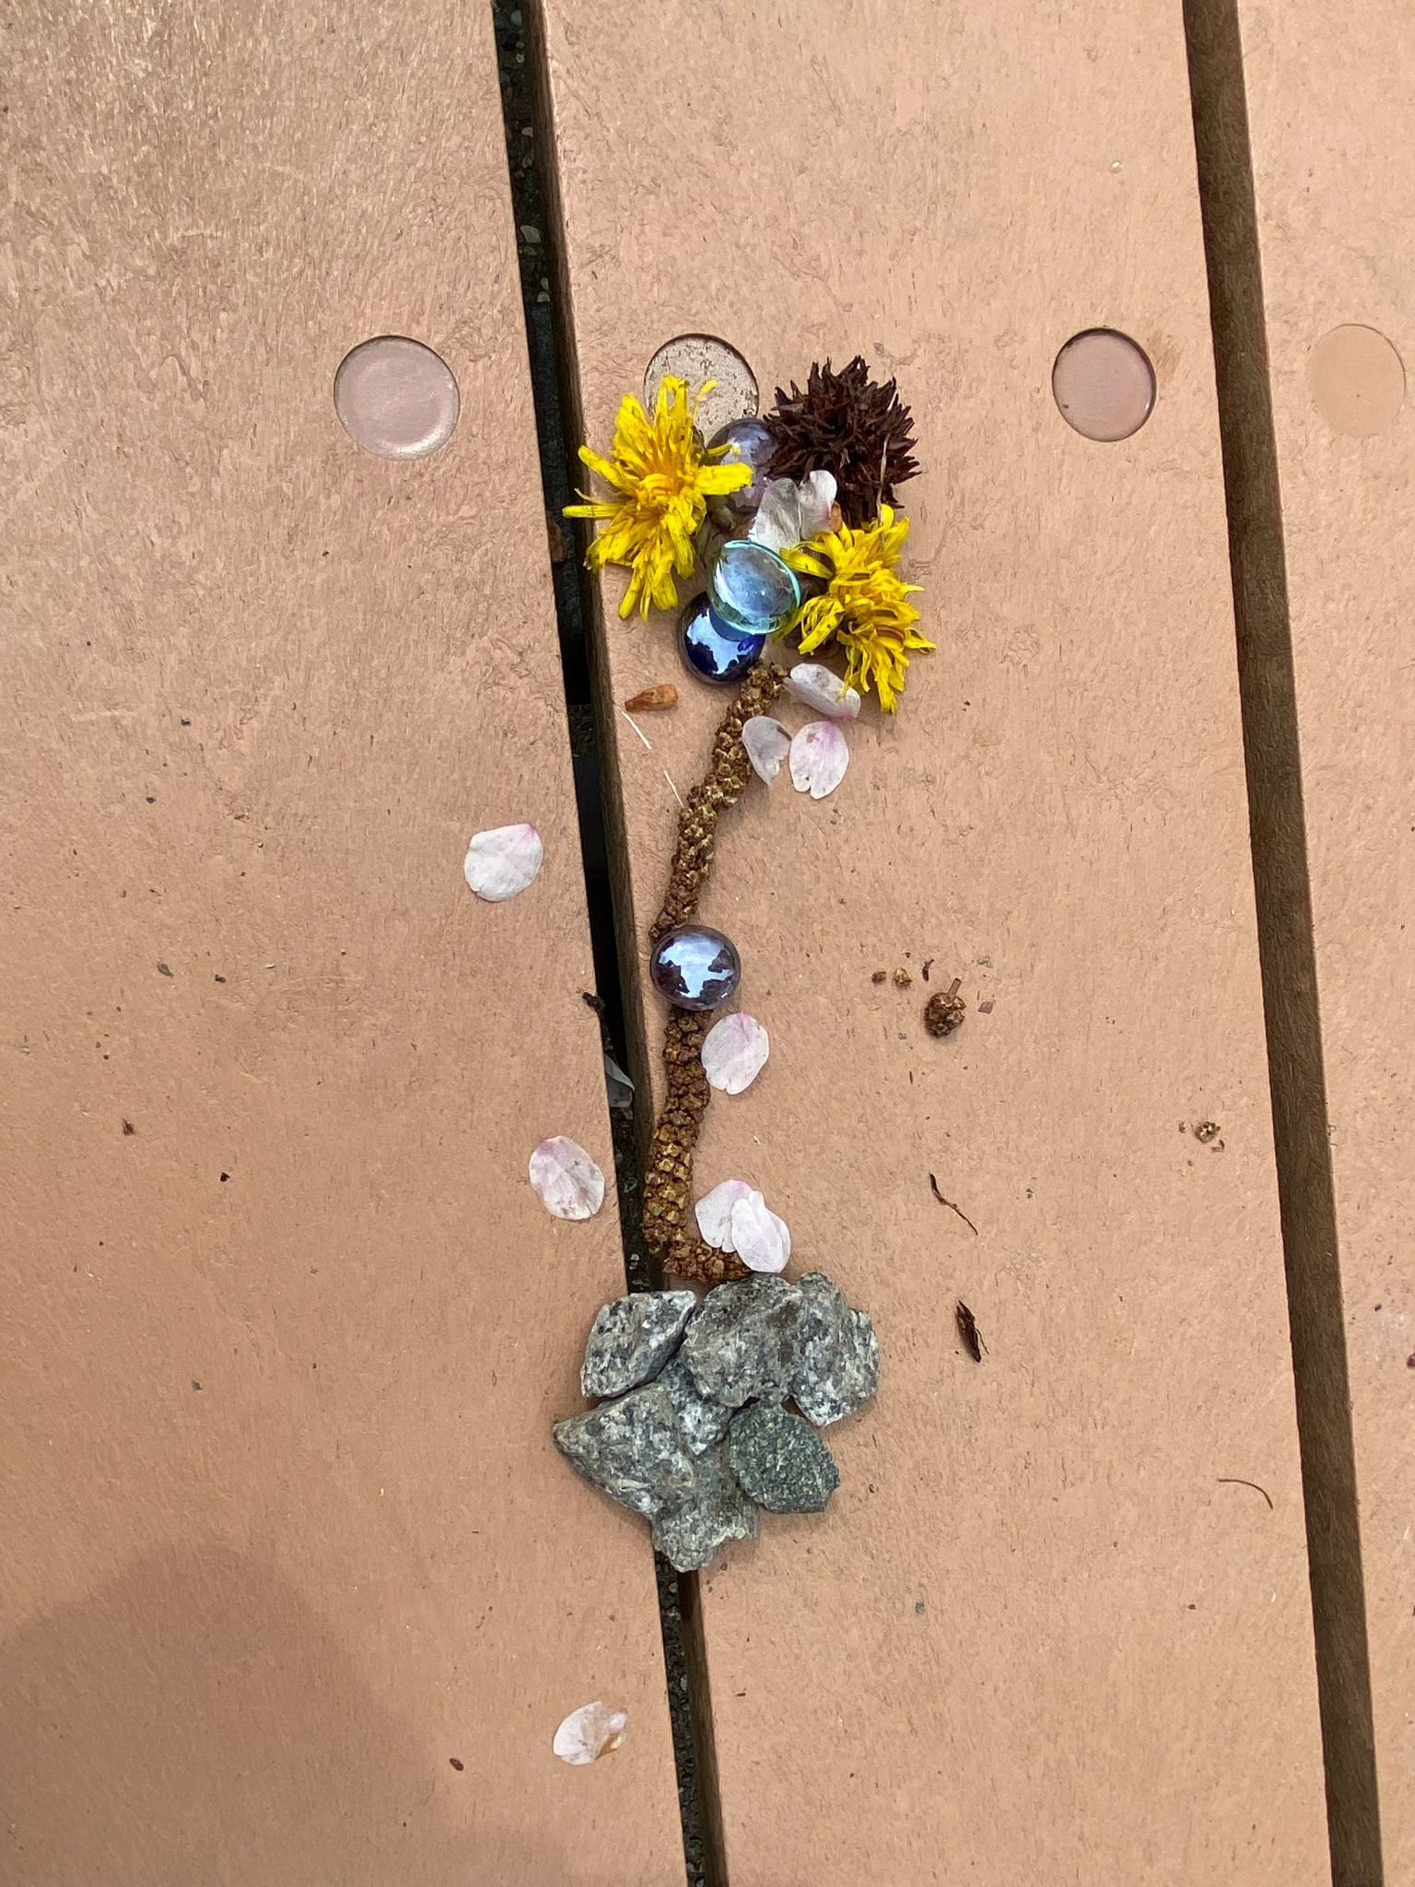
Sadie
and Charlee

Slide 6
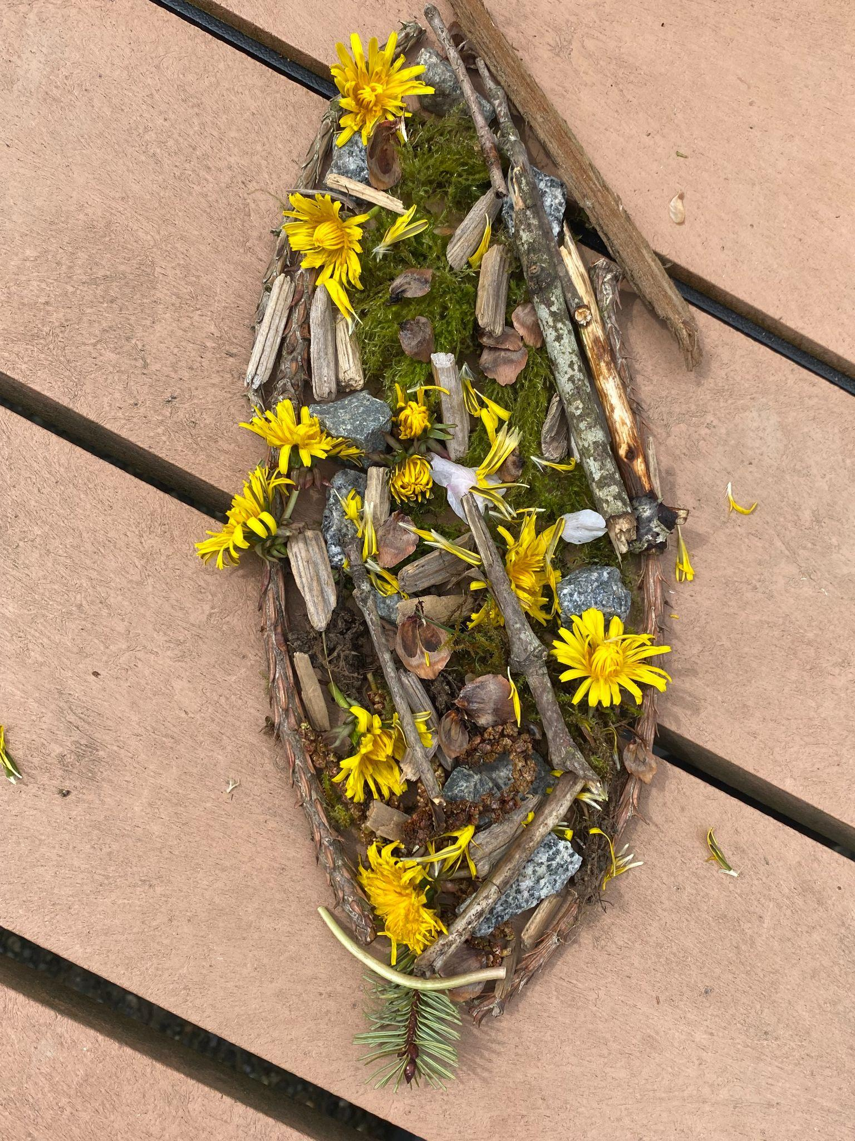
Mateo and Lincoln

Slide 7
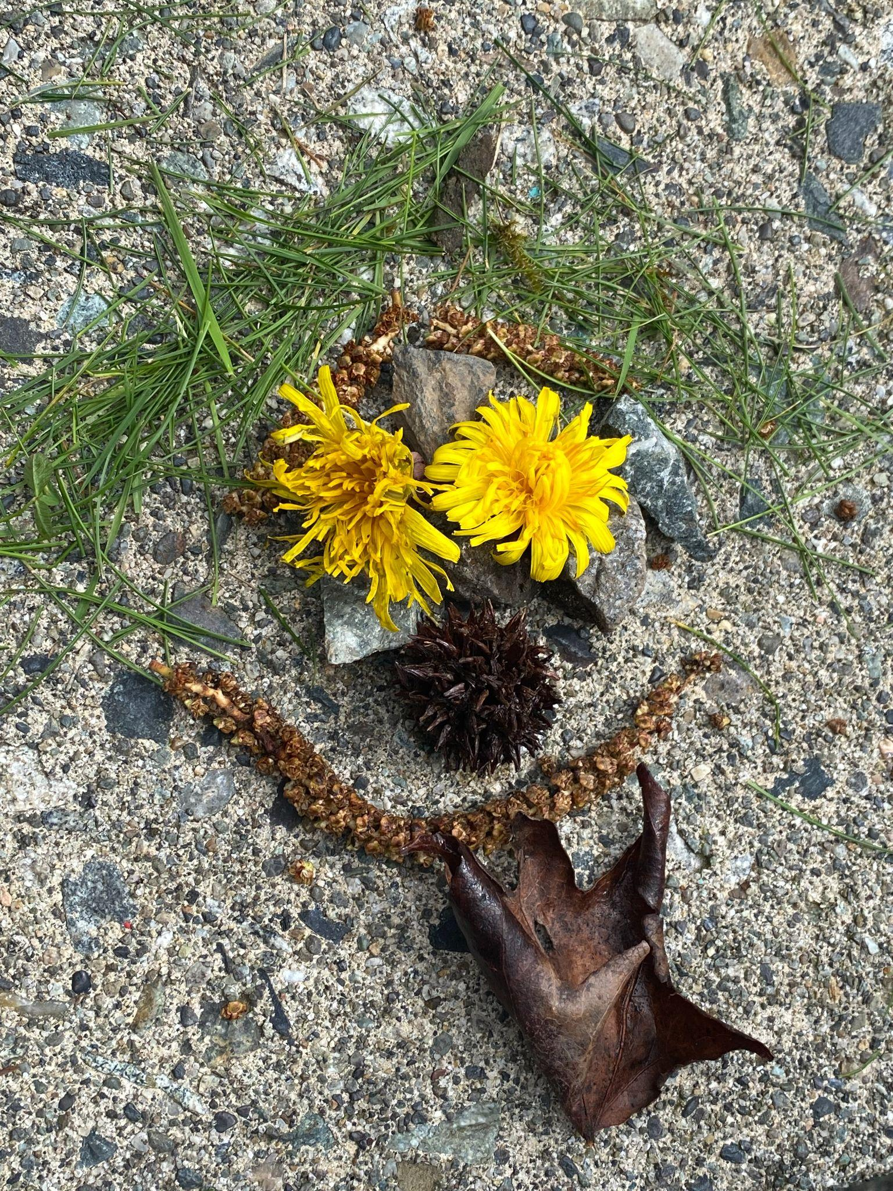
Marrcus and Colton

Slide 8
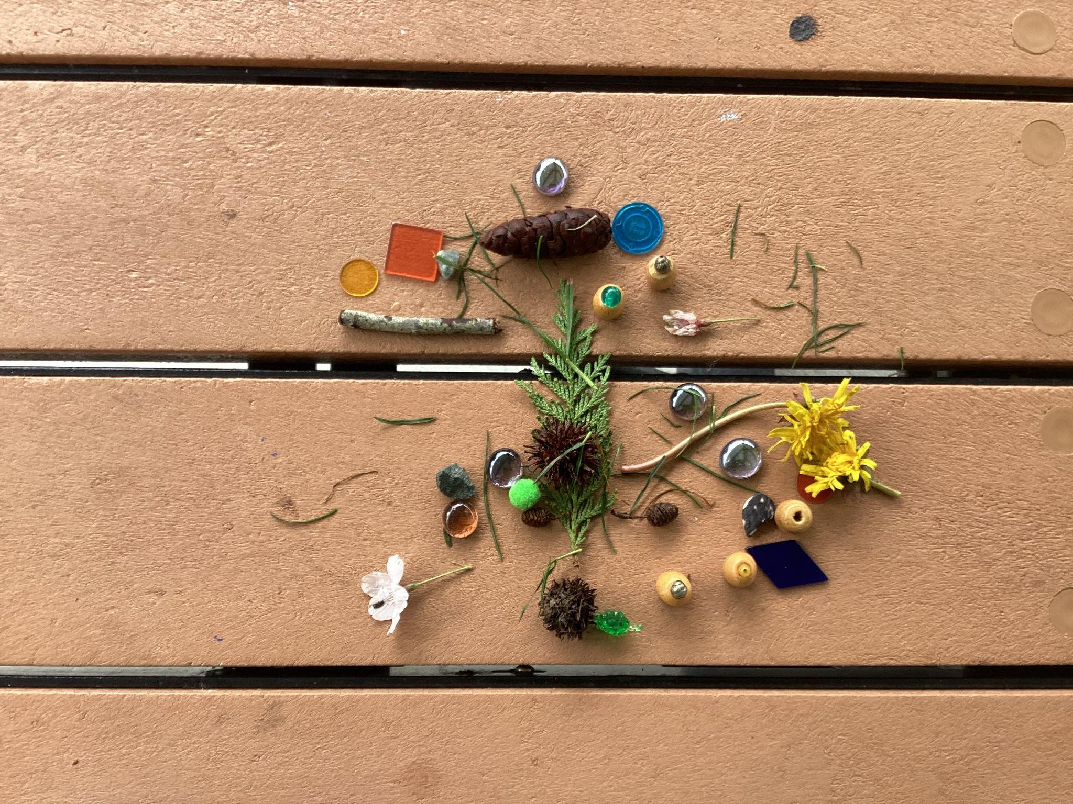
Zion and Paul

Slide 9
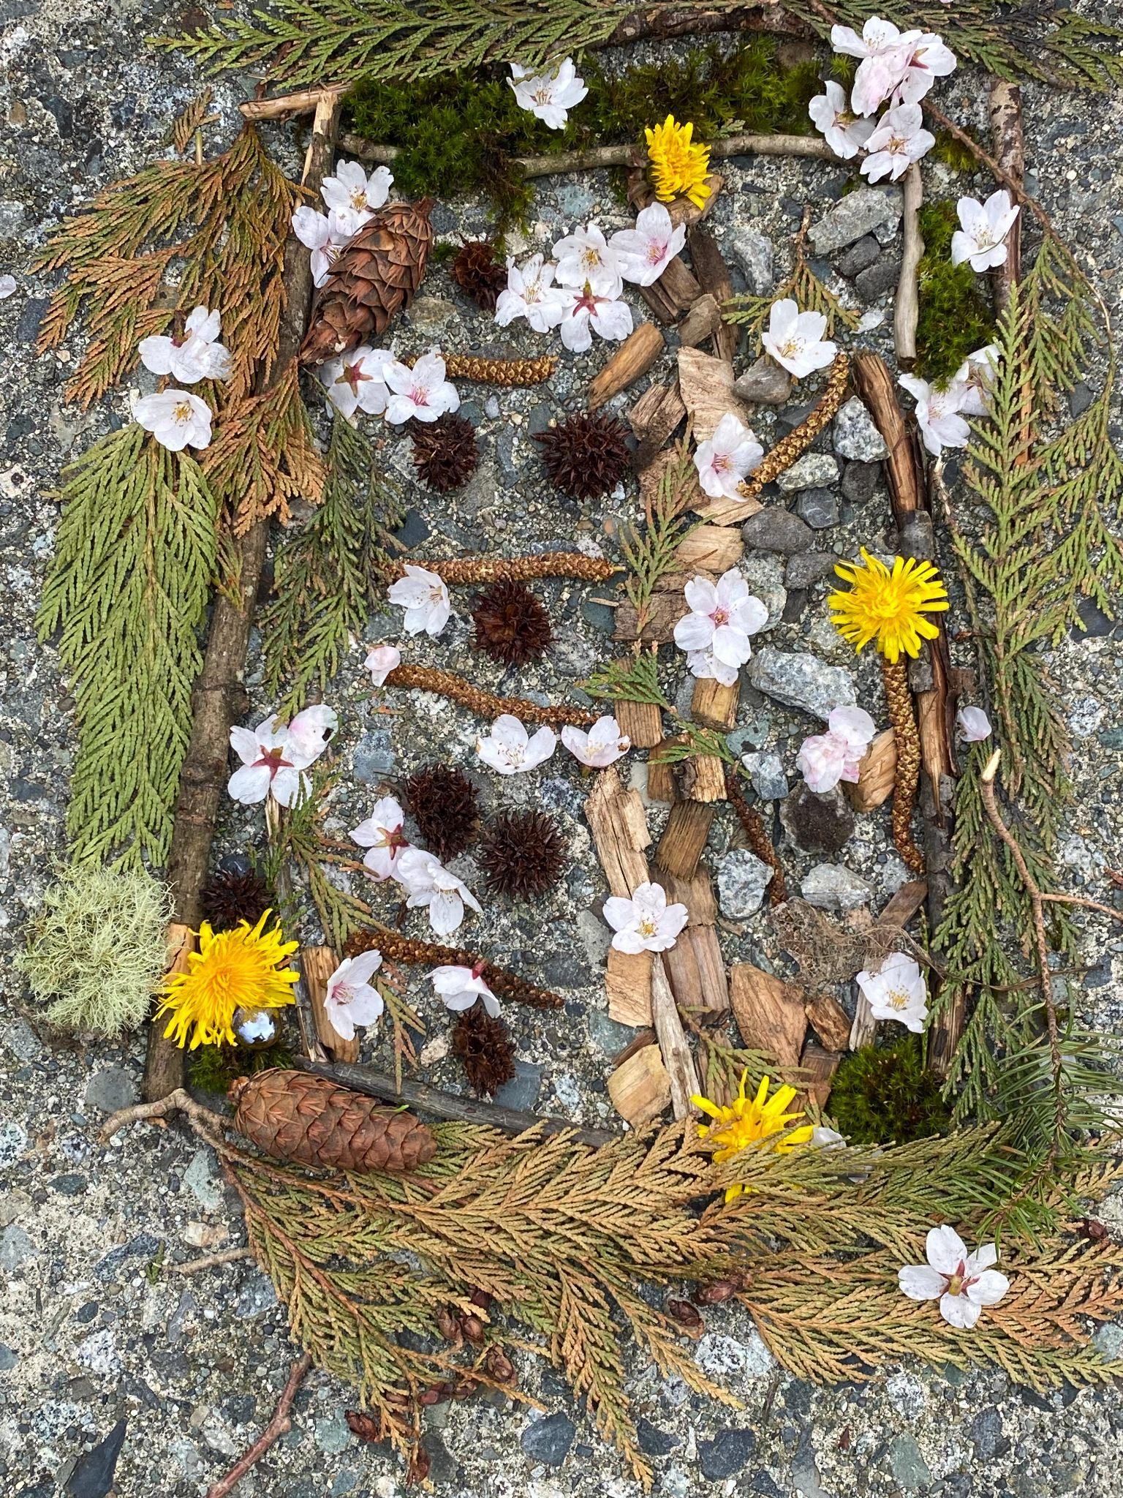
Katalina
and Varvara

Slide 10
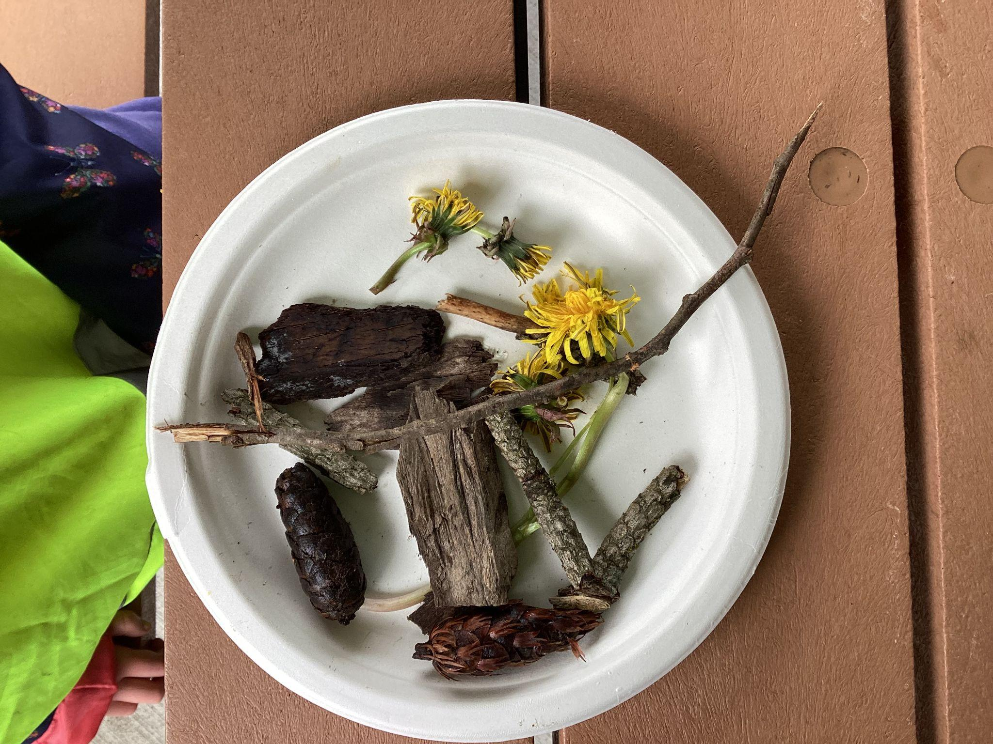
Peyton

Slide 11
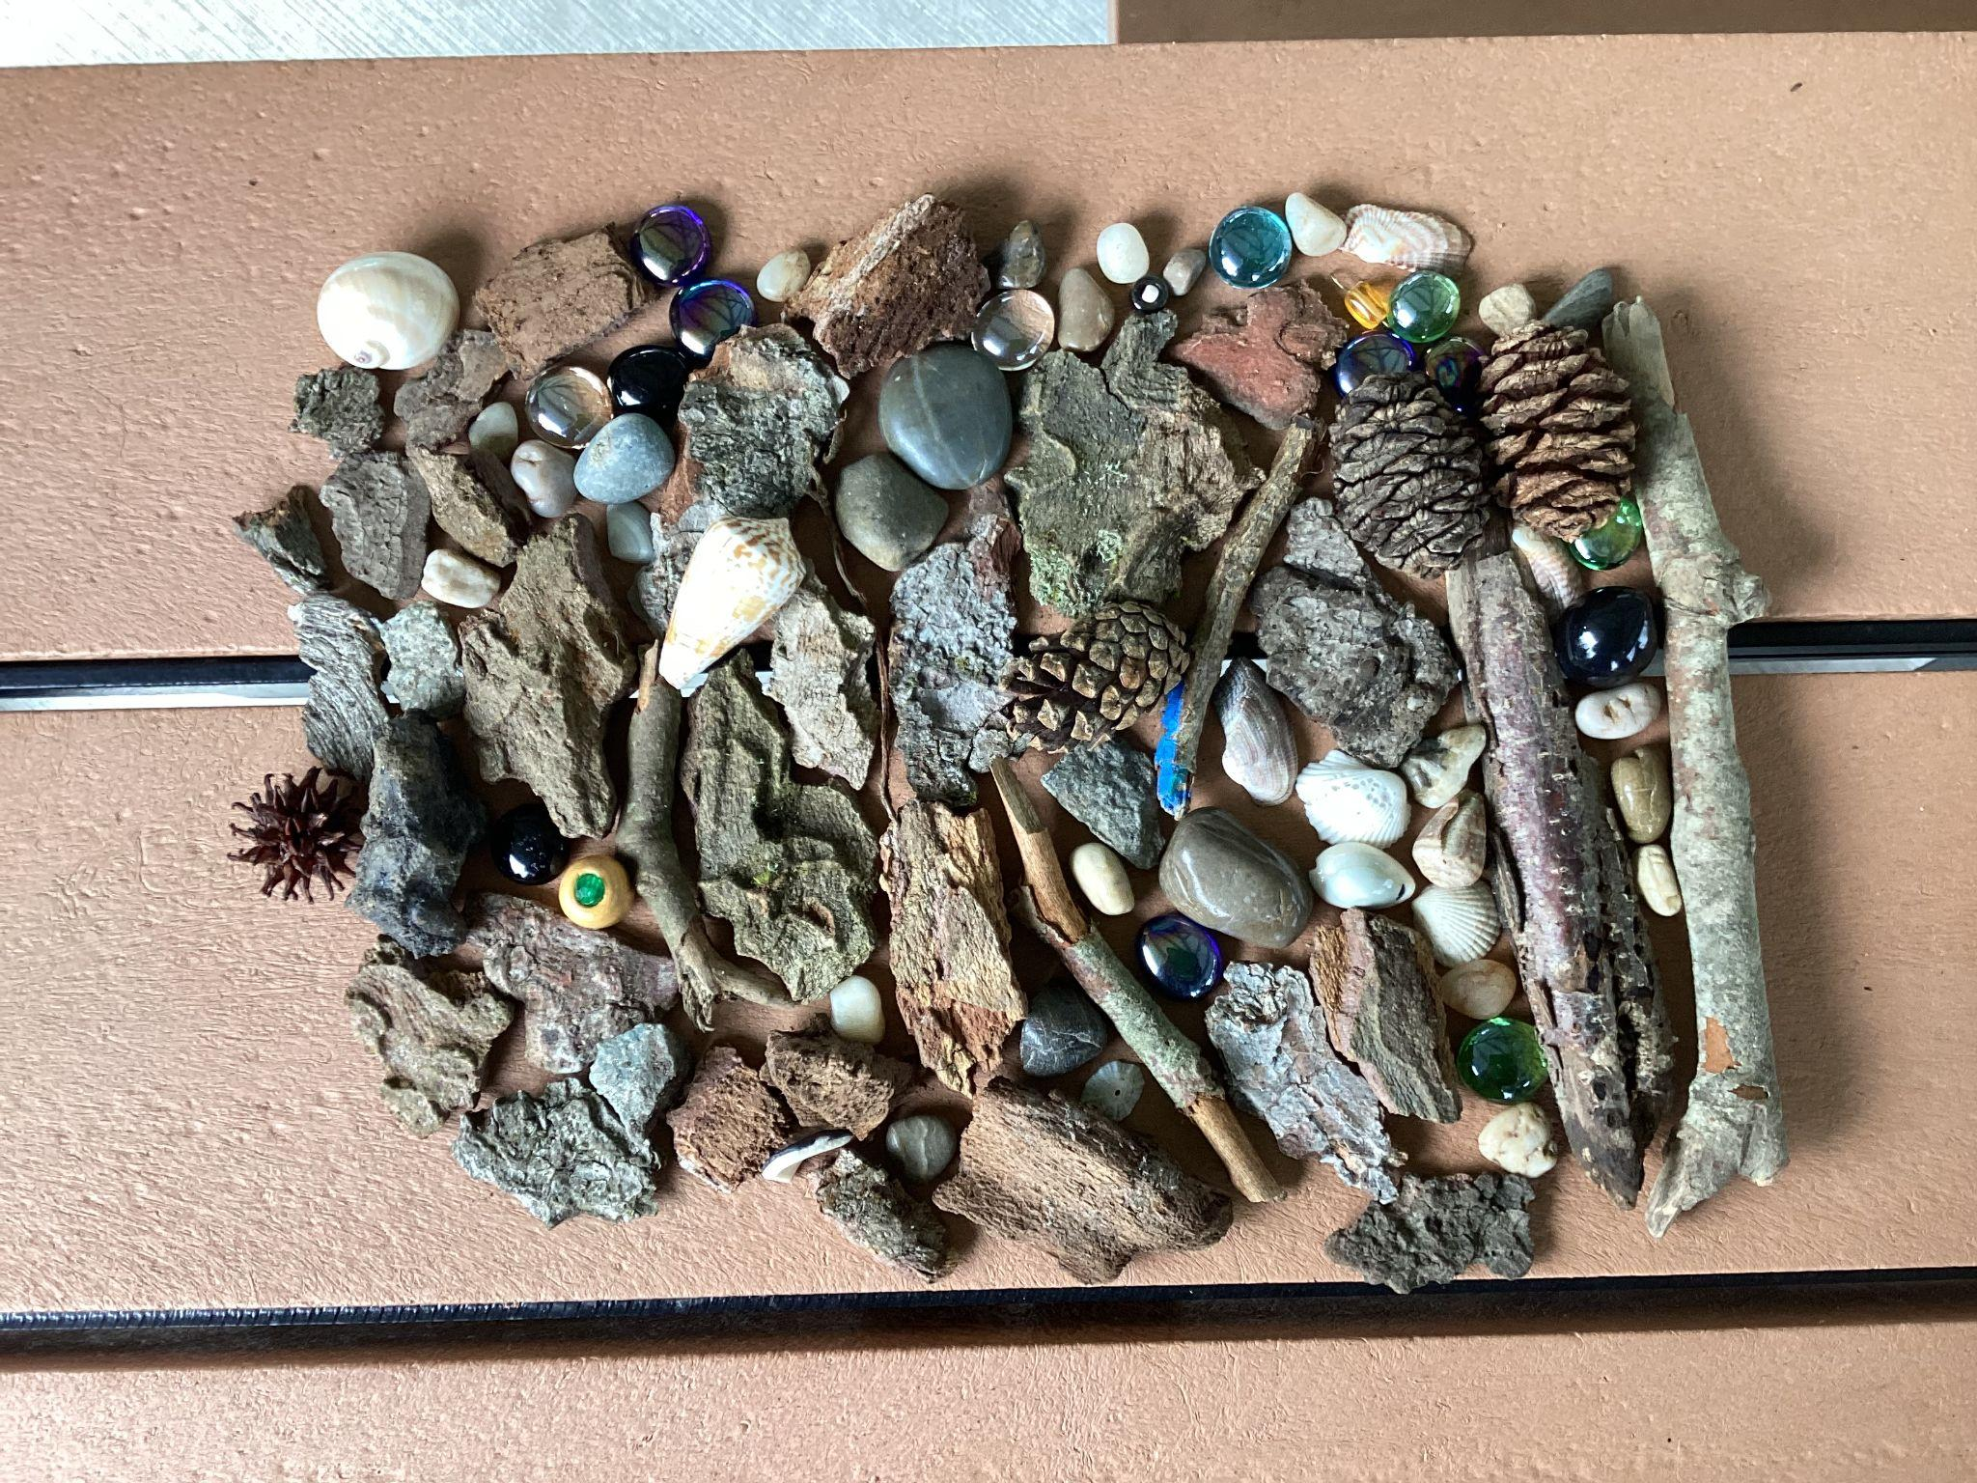
Henry

Slide 12
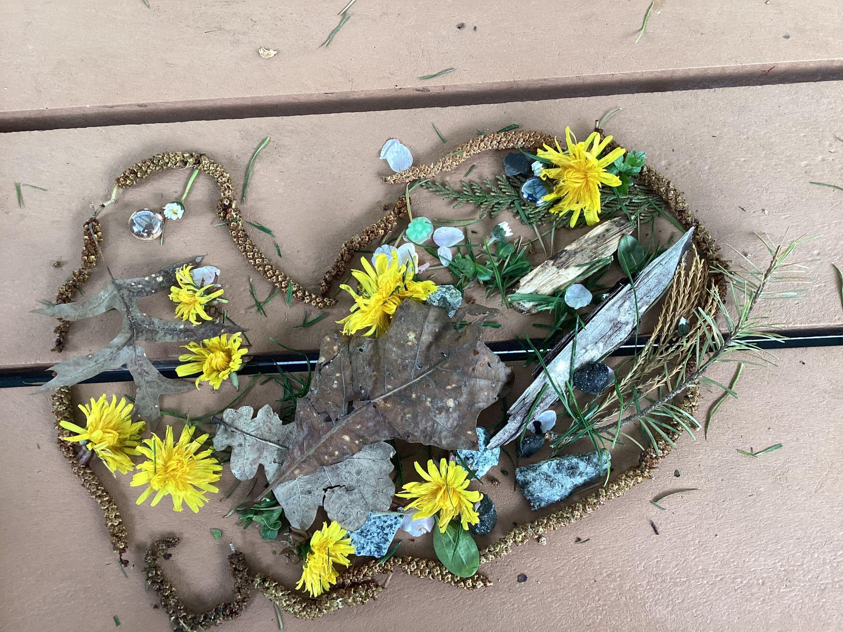
Daamya and Cyprus

Slide 13
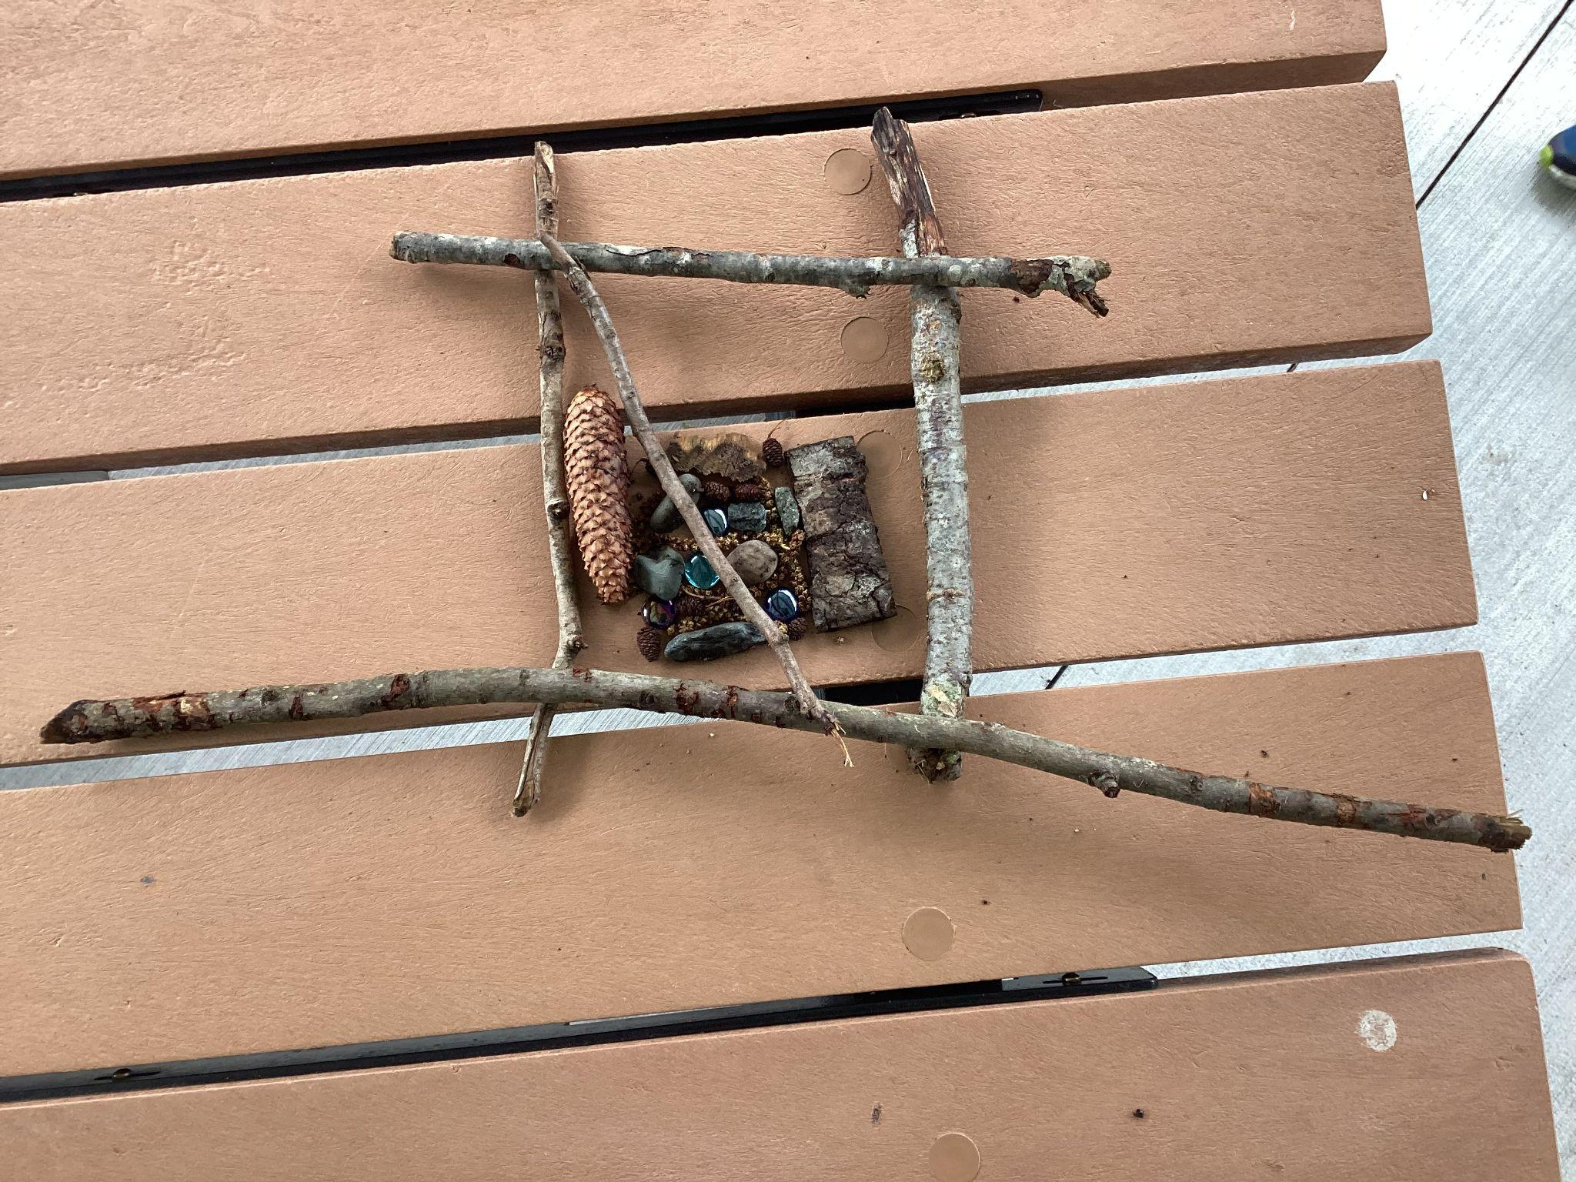
Zach and Sebastian

Slide 14
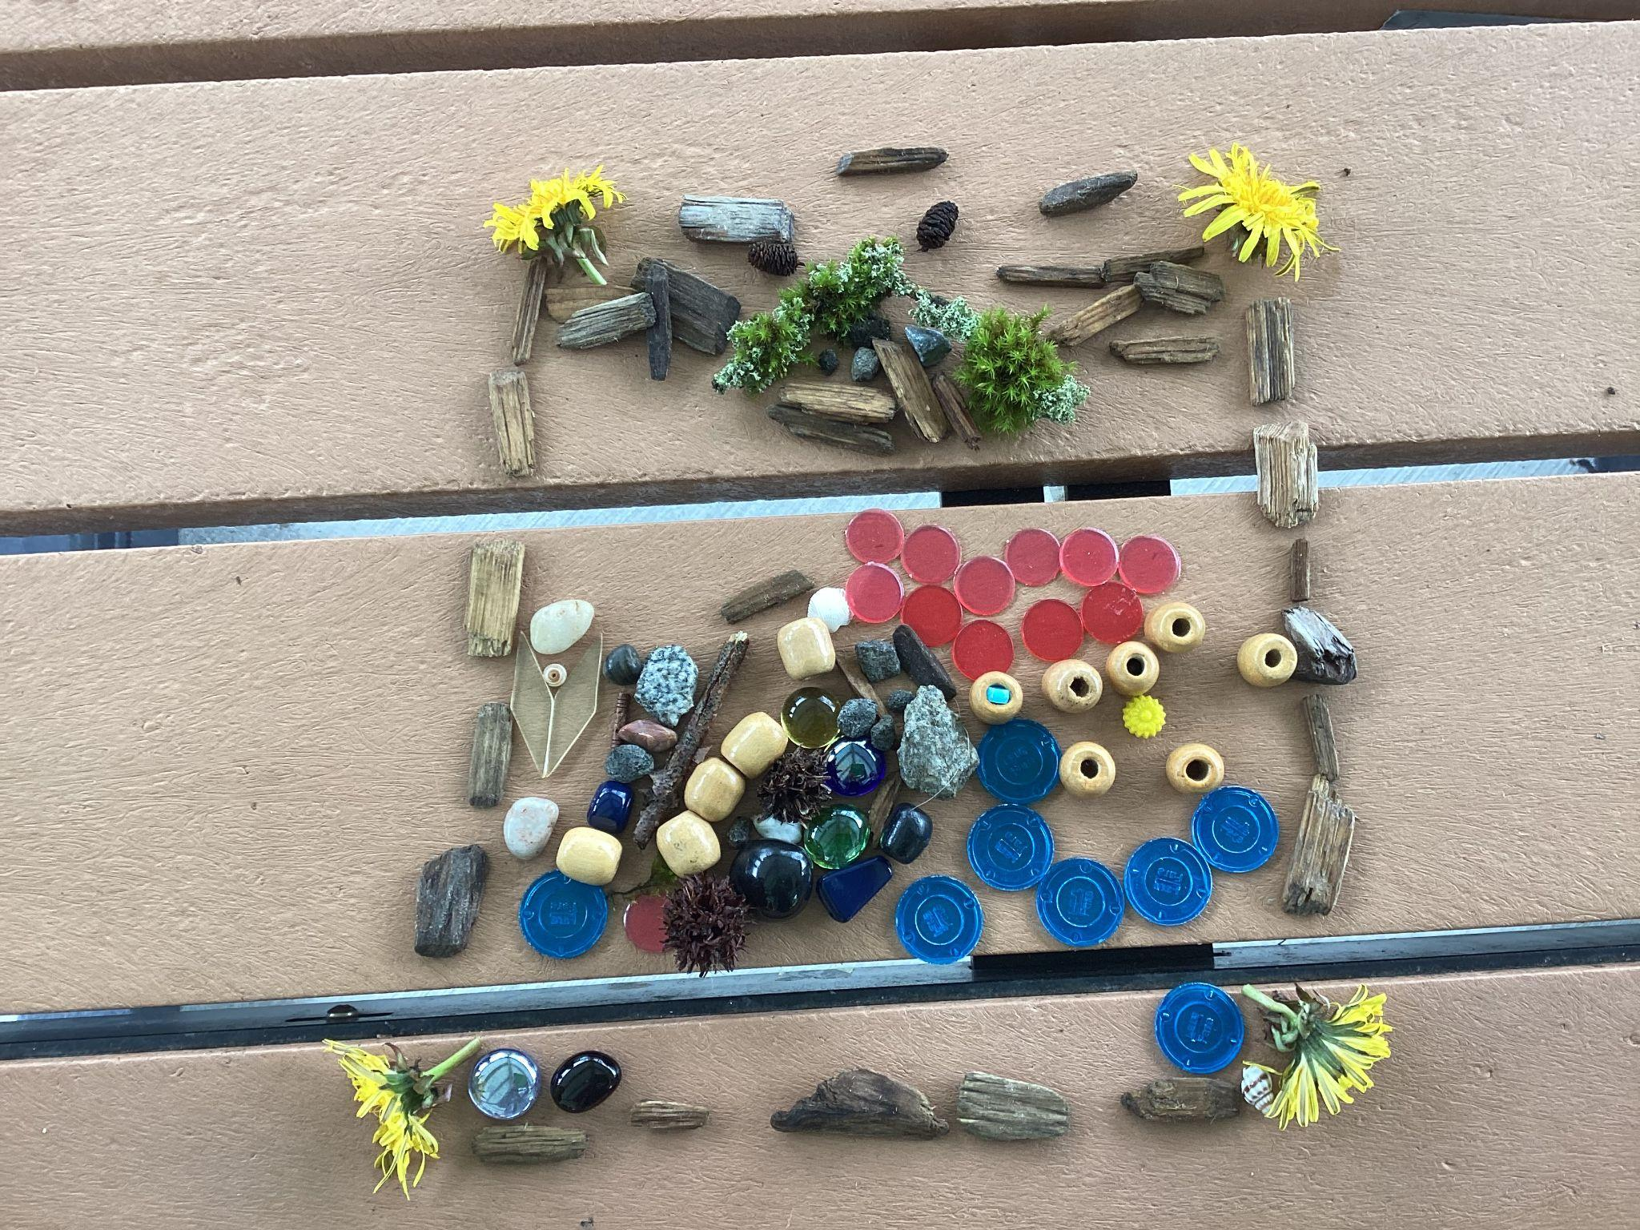
Rheya and Daegan

Slide 15
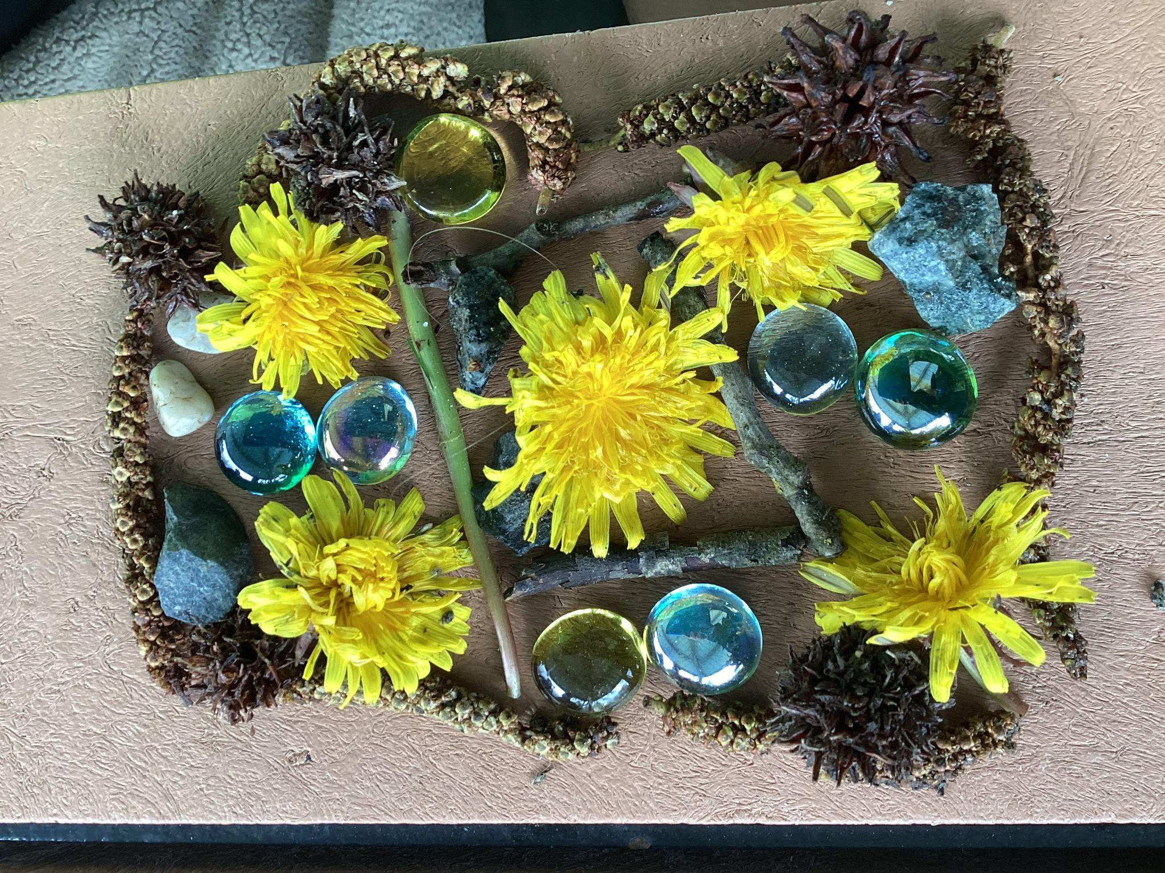
Daniel and Taylor

Slide 16
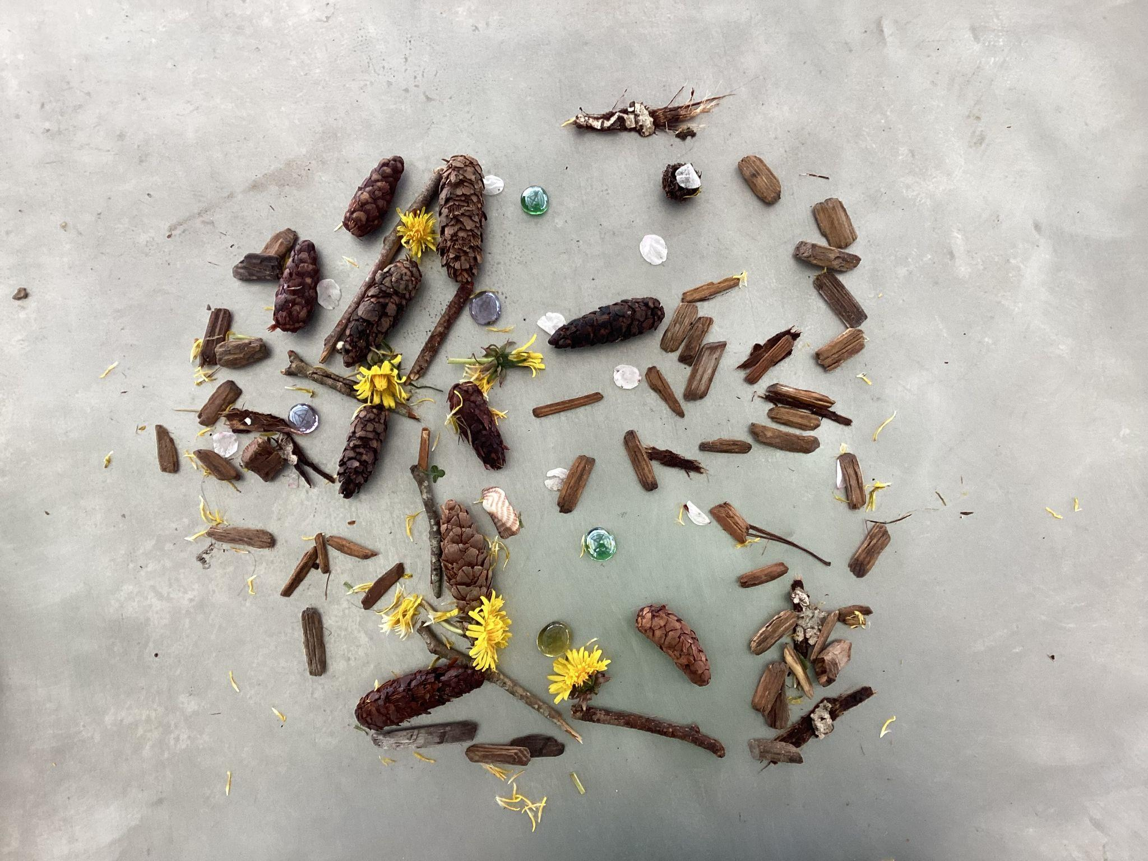
Bella and Sienna

Slide 17
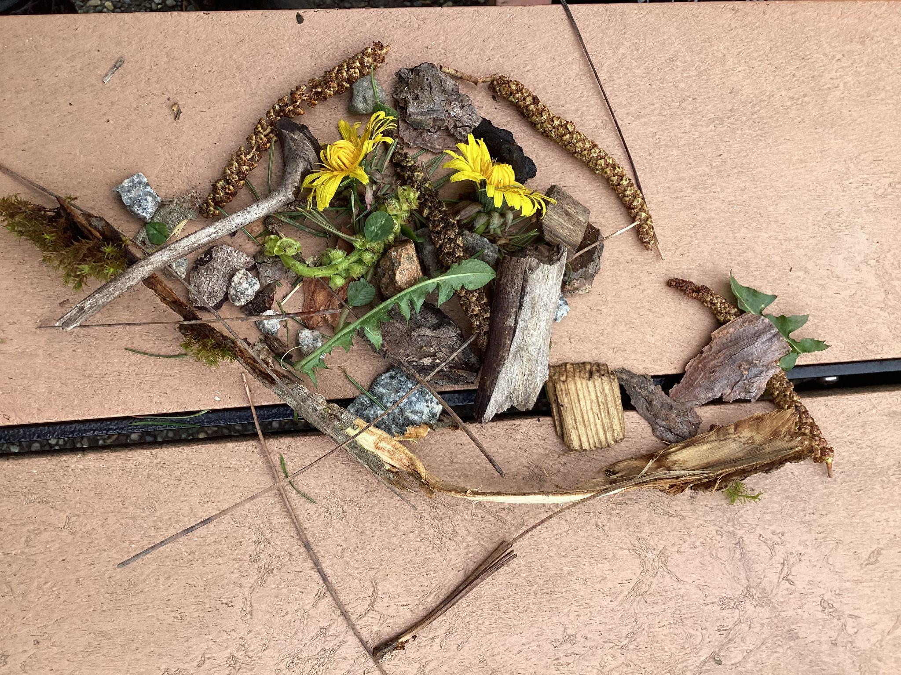
Alex and Logan

Slide 18
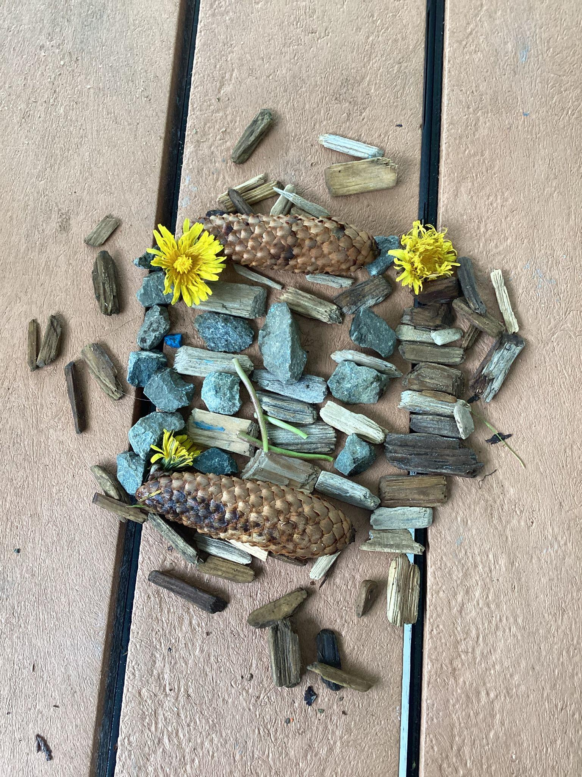
Cassidy and Caroline

Slide 19
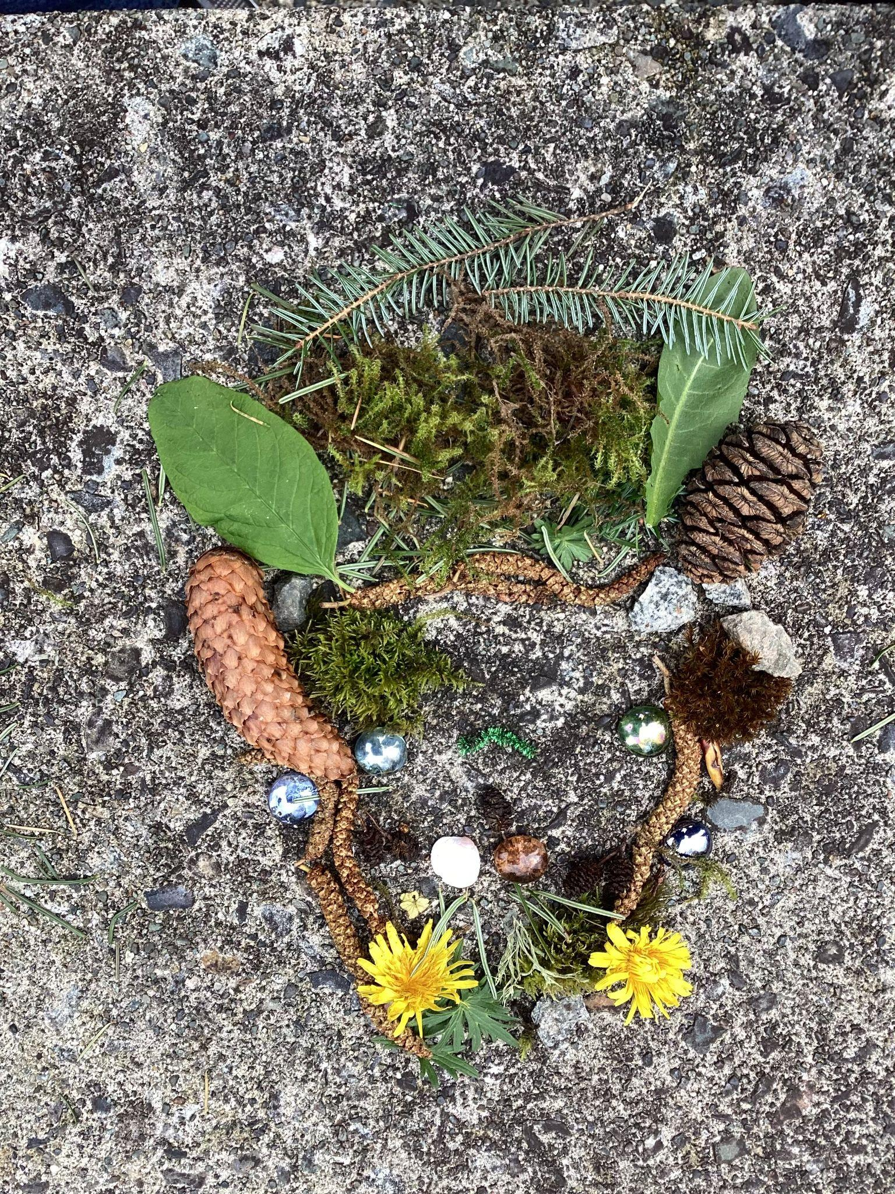
Cyprus H and Oscar

Slide 20
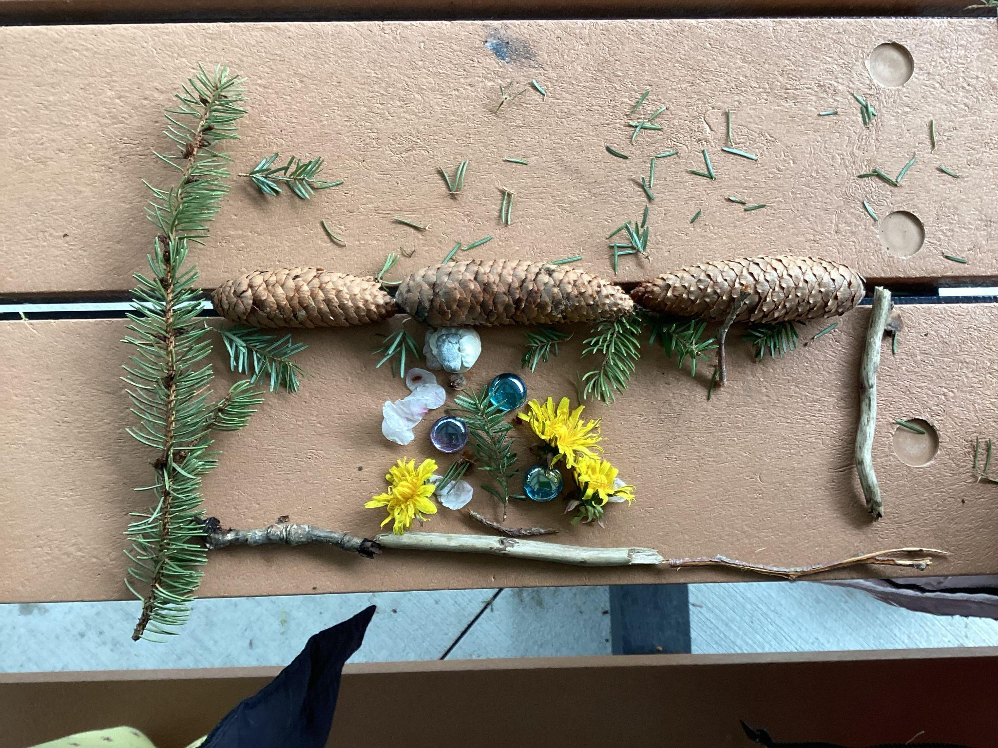
Skye and Izabella

