Slide 1
Jazz Aline Danis
Manitoba Artist

Slide 2
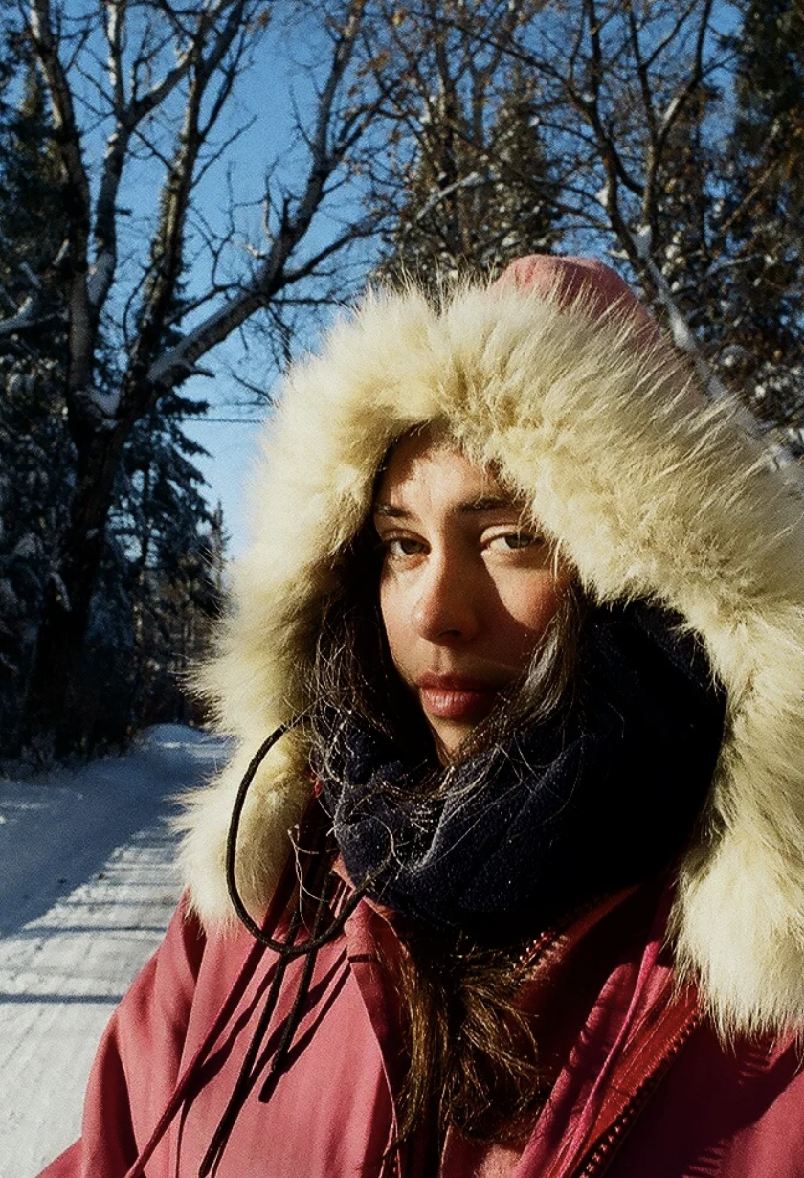
“I often imagine myself on the great endless, frozen plains of Lake Winnipeg, the wind howling-everything blanketed in white. That's my canvas.
A place of emotional violence, beauty and solace. A place where I re-imagine us in the land, that’s what my art is all about."

Slide 6
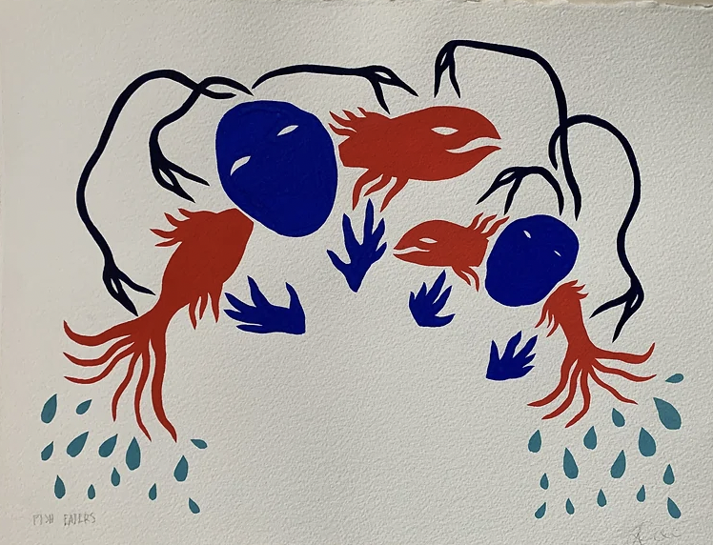

Slide 8
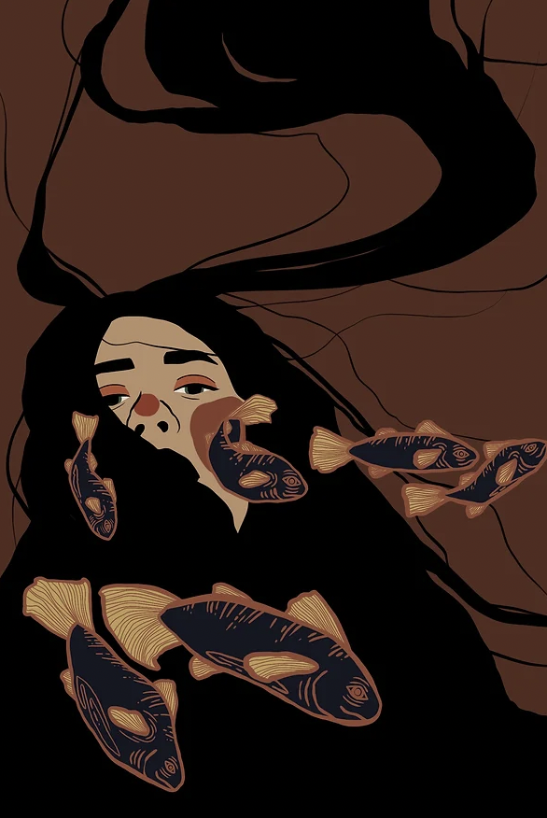

Slide 10
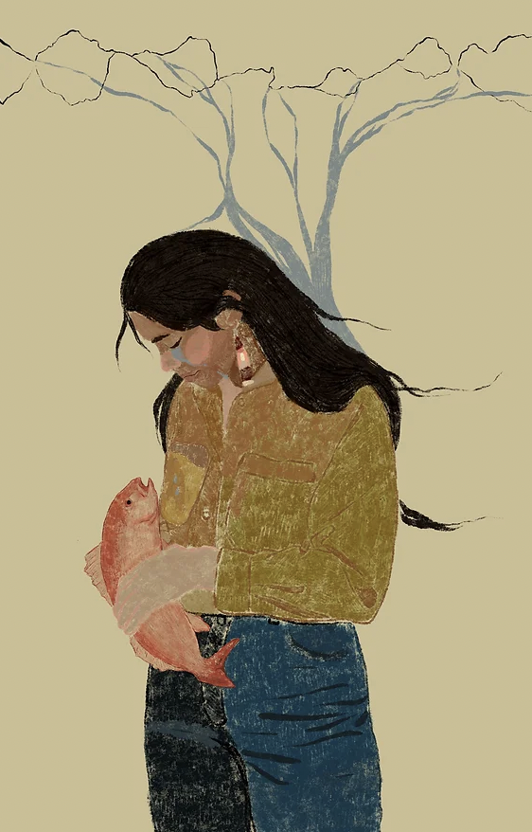

Slide 13
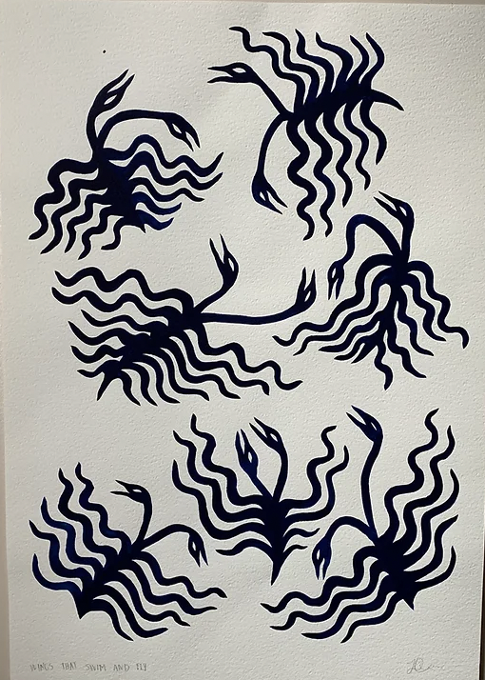

Slide 15
